Slide 1
Adam Zhu
Ranged Weapons
MechMechanics
Weapon Handler
Merging

Slide 2
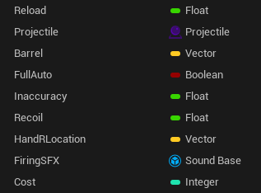
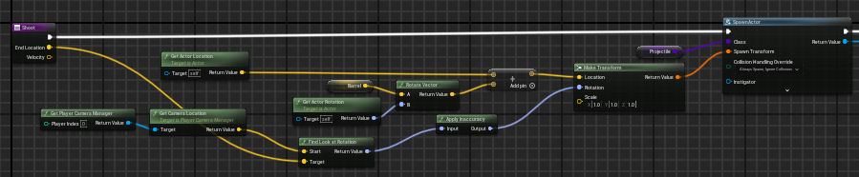
Ranged Weapon
The base RangedWeapon class contains all important information about the weapon such as name, reload, projectile it shoots, and cost.
All ranged weapons extend this class, which includes functionality for shooting and animations.

Slide 3
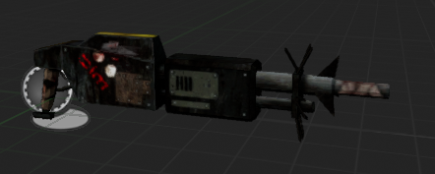
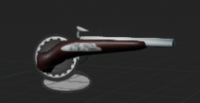
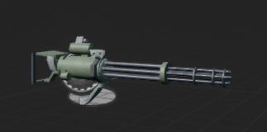
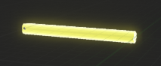
Ranged Weapon Variants
Some ranged weapons like the Scrap Spitter are fully automatic, meaning that you can shoot quickly just by holding down the mouse.
Other ranged weapons like the Flintlock are Hitscan based with instant projectiles.
The Minigun is both fully automatic and hitscan based.

Slide 4
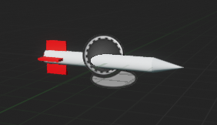
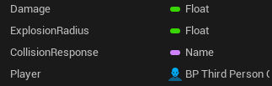
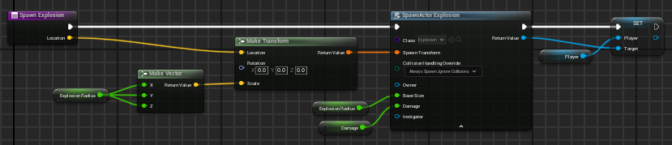
Projectile
The base Projectile class contains damage, explosion size, and ProjectileMovement component.

Slide 5
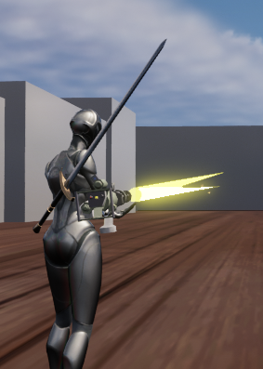
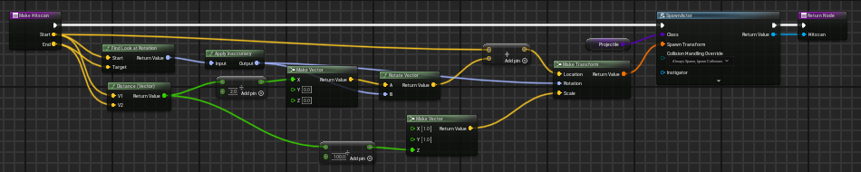
A Closer Look: The Hitscan
The Hitscan projectile is a yellow beam, representing a tracer that traveled through the air. Damage is applied at the other end of the hitscan.
Weapons that use hitscans must override the Shoot function and have another function to spawn in the hitscan properly.

Slide 6
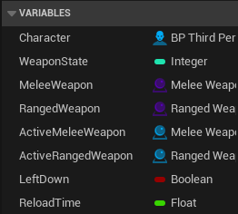
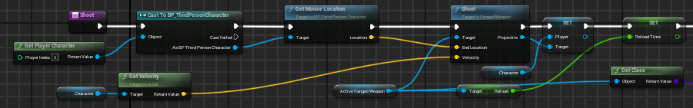
WeaponHandler Component
The WeaponHandler component handles all weapon functionality for the player.
Since all ranged weapons are children of the RangedWeapon class, it is much easier for the WeaponHandler component to implement weapon functionality.

